Slide 1


Completion and Review of Teamfight Tactics Project
2250758 林继申 (组长)
2251730 刘淑仪
2252712 杨兆镇
2252843 杨宇琨
GitHub: https://github.com/MinmusLin/Teamfight_Tactics
Speaker: 杨宇琨 林继申
2024 - 01 - 02

Slide 2
Brief Introduction
Introduction to team roles and responsibilities, technology stack and tools, schedule and timeline, functional implementation and bonus points

Slide 3
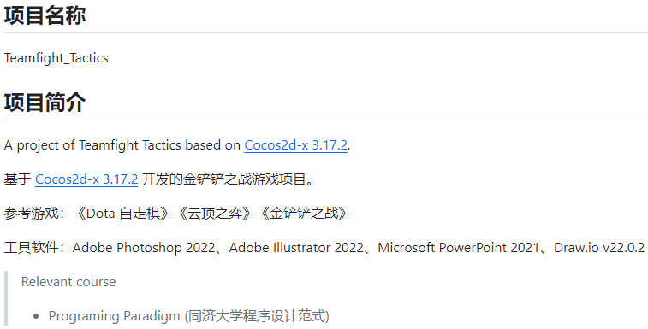
Brief Introduction

Slide 4
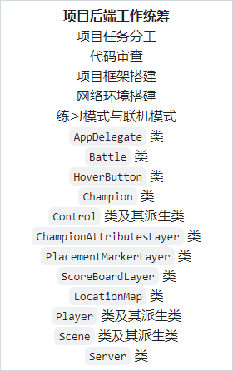
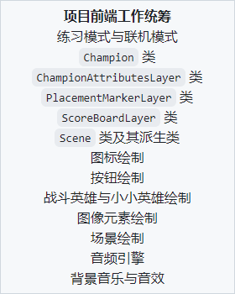
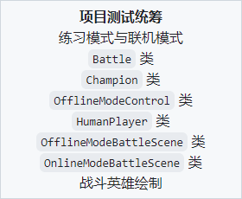
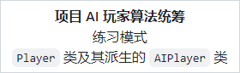
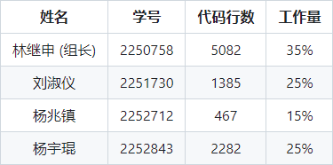
Team Roles and Responsibilities
林继申
刘淑仪
杨宇琨
杨兆镇
Contributions (git log)

Slide 5



Technology Stack and Tools
Cocos2d-x 3.17.2
C++
Git
Git effectively supports team collaboration, aiding teams in working together more efficiently during project development by facilitating communication and code management.
Compared to cocos2d-x 4.0, there are richer documentation and tutorial resources available, and the development environment is adequate.
When developing games within the Cocos2d framework using the C++ language, it provides performance advantages and flexibility.

Slide 6
Schedule and Timeline
2023.11.22~2023.12.4
Stage One:
Setting up the environment to learn Cocos2d-x Understanding code conventions, learning Markdown Creating a repository, mastering Git usage.
2023.12.8~2023.12.12
Stage Two:
Configure socket networking environment.
Set up the basic framework. Implement the AppDelegate class and the Server class to
lay the foundation for multiplayer mode.
2023.12.16~2023.12.22
Stage Three:
Implemented various functionalities for program-user interaction. Completed drawing related hero and scene images. Preliminarily implemented the necessary classes
for the combat scene.
2023.12.23~2023.12.27
Stage Four:
Implemented the battle scene and AI algorithm.
Enhanced the overall game logic by integrating
all basic functionalities.
2023.12.28~2023.12.31
Stage Five:
Implemented the battle scene and AI algorithm.
Enhanced the overall game logic by integrating
all basic functionalities.

Slide 7
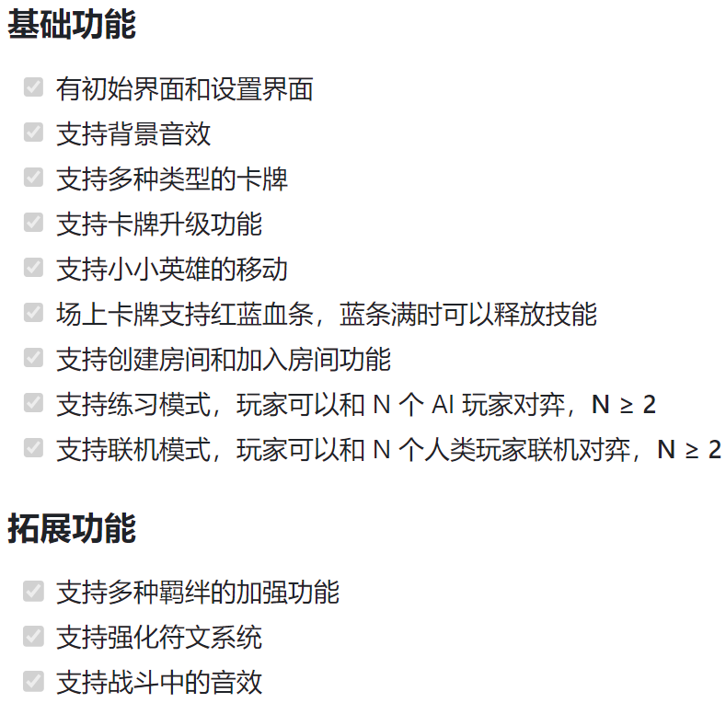
Functional Implementation

Slide 8
Bonus Points
版本控制和团队协作
合理使用 Git 控制版本，将项目开源至 Github
团队成员分工合理平等
代码质量和安全
使用单元测试保证代码质量
合理地抛出异常和处理
功能和架构
界面精美
项目目录结构清晰
其他加分项
没有内存泄露
程序运行过程不会发生崩溃情况
尽可能多地使用了 C++11 特性
类型推导、构造函数参数列表初始化、基于范围的 for 循环、继承构造函数、空指针关键字 nullptr、修饰常量 constexpr、新随机数、lambda 表达式、时间库 chrono 和线程库 this_thread、Unicode 编码支持
商店推荐系统与 AI 落棋算法
规范统一的代码风格
游戏还原度高
常变量的集中定义

Slide 9
General Design
An outline of out project

Slide 10
Design Philosophy and Principles
High Cohesion, Low Coupling
01
02
03
Definition of Game Mechanics and Game States
Class Planning and
File Classification
Refactoring
This aims to enhance code readability, maintainability, making it easier to understand, modify, and extend. Refactoring does not involve adding new features but focuses on improving the internal structure of the codebase, eliminating redundancy, and enhancing its overall quality.
Define the core mechanics, objectives, and rules of the game. Define the various states the game may be in (such as main menu, gameplay, game over). Plan and design a single game scene.
Based on the planned game flow, organize the classes for the objects appearing in the game (primarily categorized into base classes, derived classes, method classes, and management classes), implementing them in different files.

Slide 11
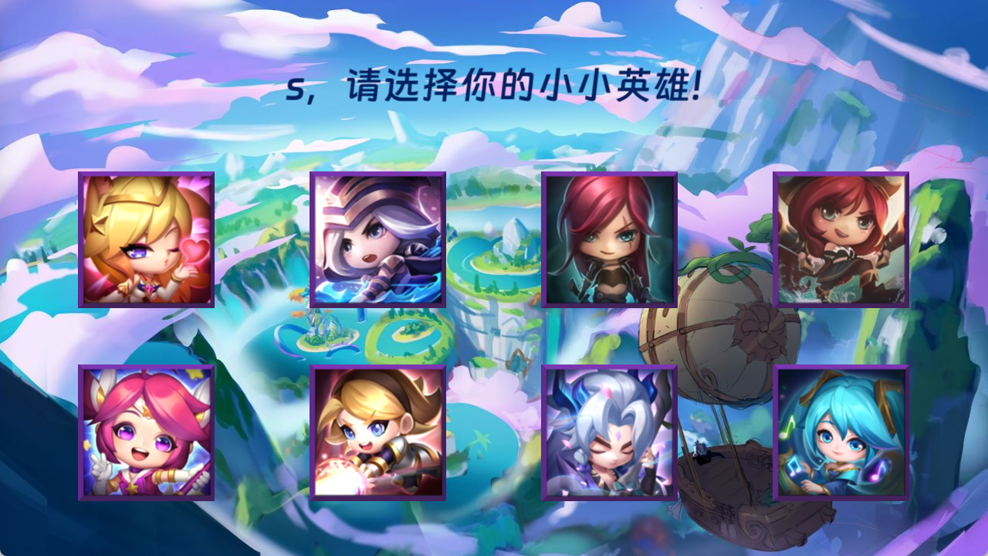
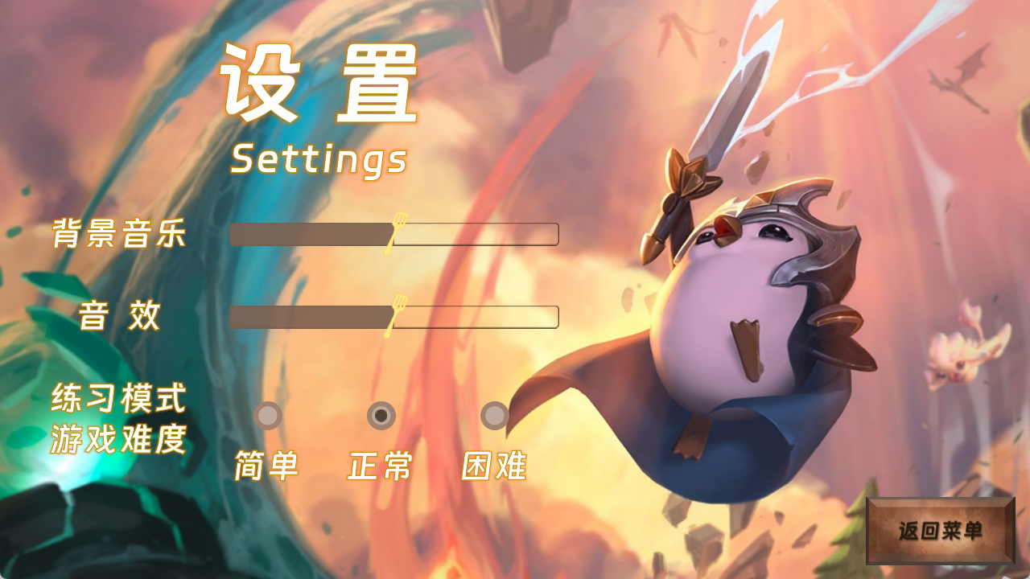


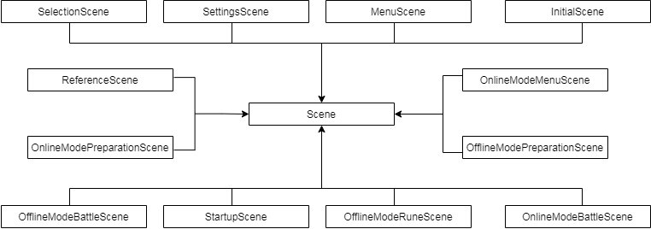
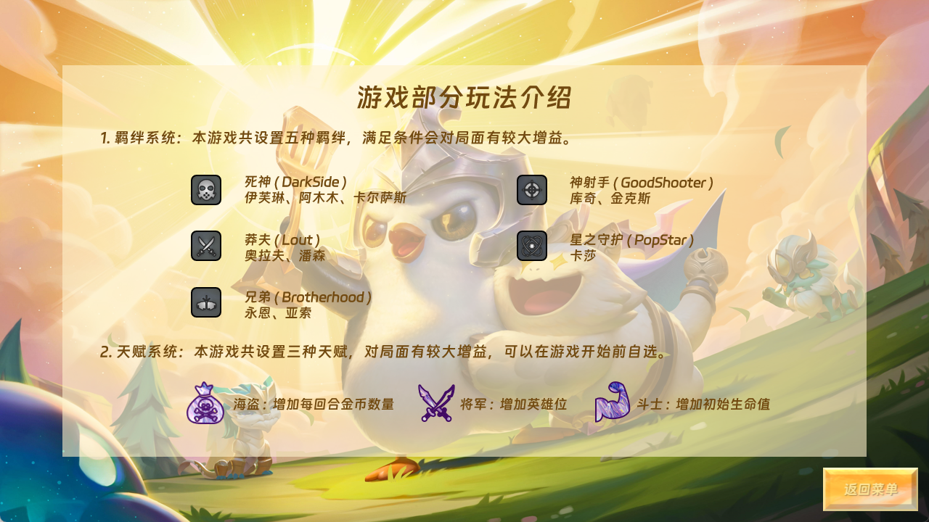

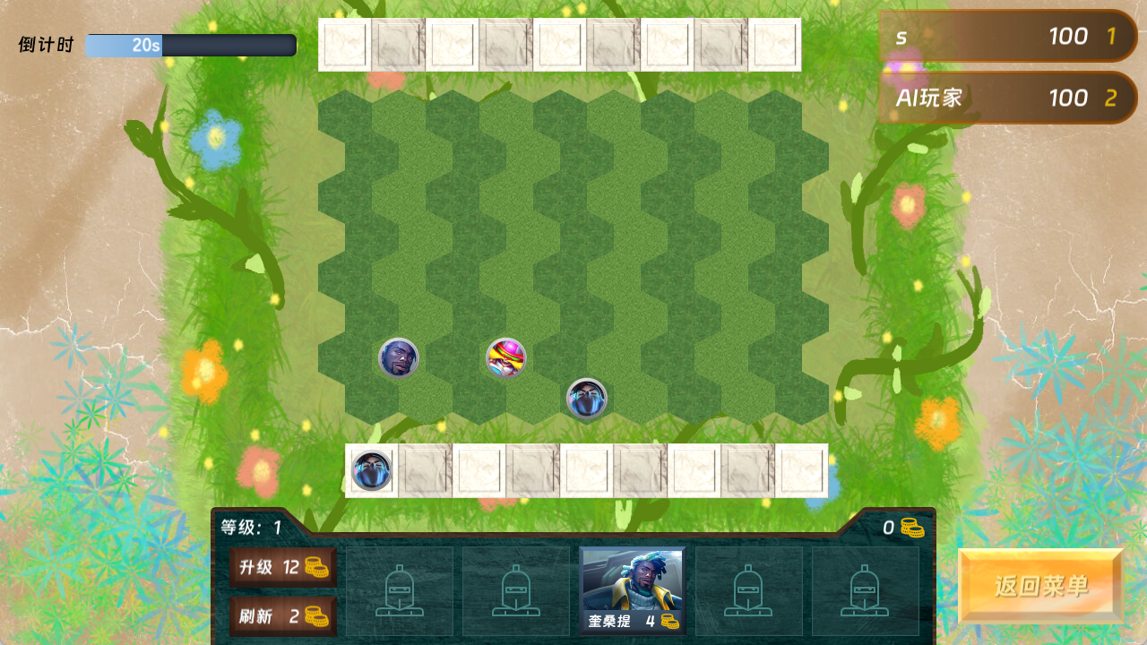
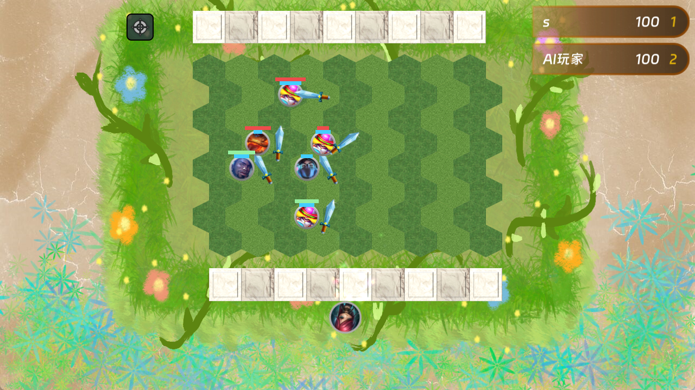
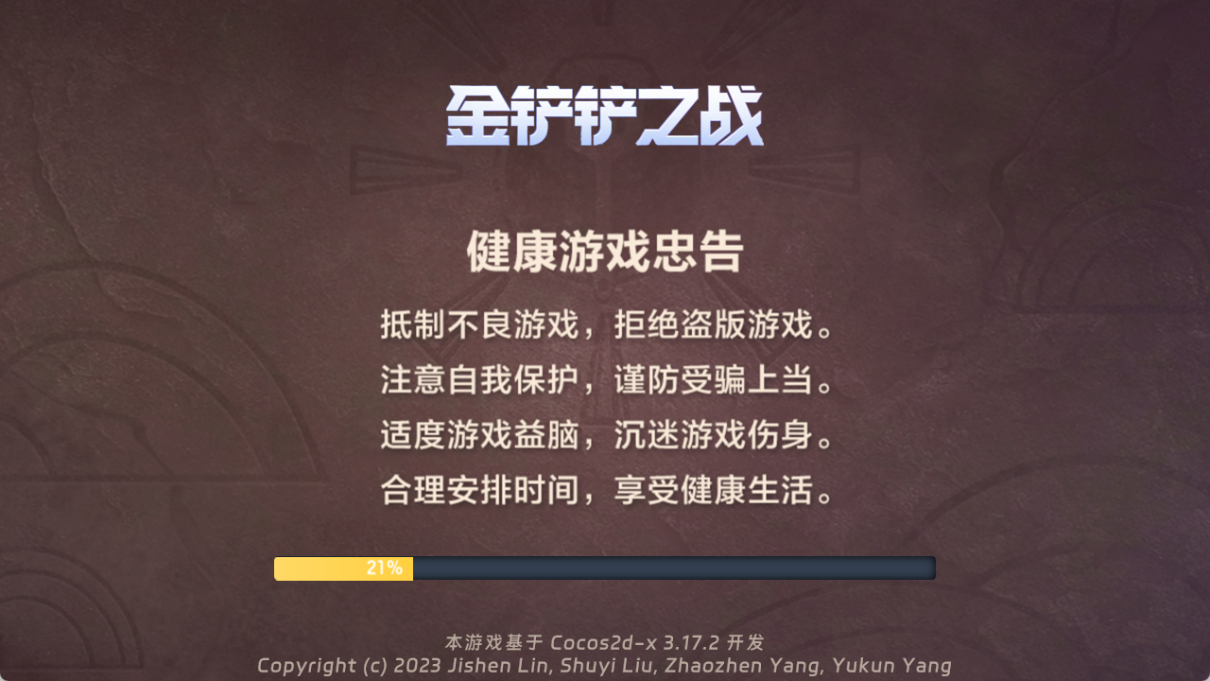
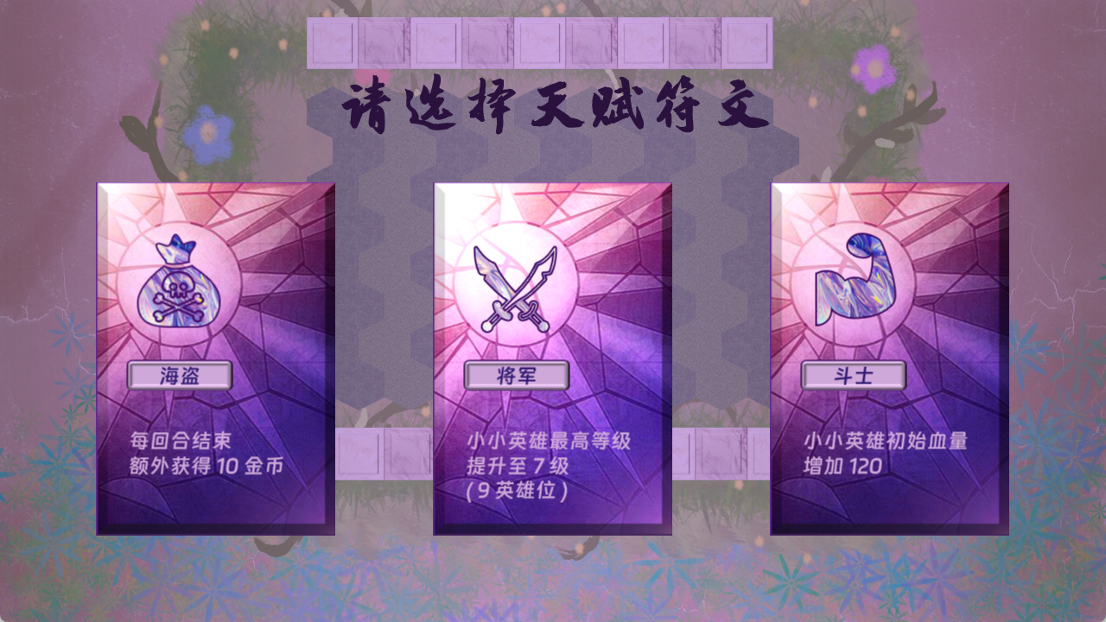
Class Scene

Slide 12




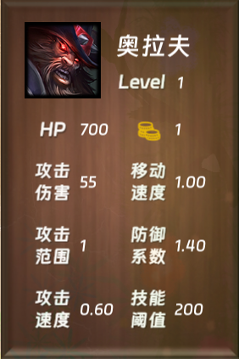
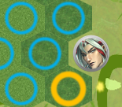
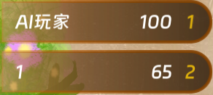
Class HoverBotton
(Hover)
Class Champion
Class Layer
Class Control
Manager Class
Class Player

Slide 13
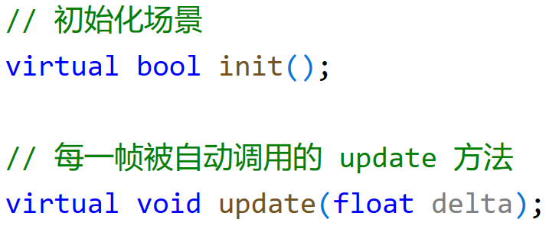
Polymorphism
In this code snippet, a virtual method is declared. This method's declaration uses the virtual keyword, indicating that it is a virtual function. Virtual functions can be declared in the base class and overridden in derived classes. This mechanism is known as polymorphism.
Polymorphism allows different objects to respond differently to the same message.
This polymorphic behavior enables you to handle an object without needing to know its exact type, only requiring knowledge that it is of the base class type. When a virtual function is called, the version that actually runs is that of the object's class, not the base class.
Such a design facilitates the creation of more flexible, extensible code structures, allowing for extension and customization of derived classes as needed, all while using a unified interface to manage various object types.

Slide 14
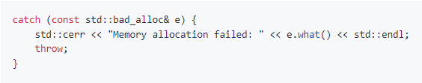
Code Safety
The Try-Catch is an exception handling mechanism used to capture and manage potential exceptions or errors within a program.
When using the Try-Catch structure, the code block is placed within a Try block, which encapsulates the code that might throw an exception. If an exception occurs within the Try block, the program immediately jumps to the corresponding Catch block. This allows for the execution of specific exception handling code without causing the program to crash.
Try Block: Contains the segment of code where exceptions might be thrown.
Catch Block: Used to capture and handle different types of exceptions. Multiple Catch blocks can be employed, with each block handling a specific type of exception.

Slide 15
Code Safety
To prevent memory leaks, we adopt a manual approach in managing dynamic memory by strictly ensuring a one-to-one match between new and delete operations. There are several instances in our project where dynamic memory deletion is meticulously managed:
1. In the Battle class, the creation of heroes is achieved through dynamic memory allocation. We create a two-dimensional pointer array championCategoryMap[BATTLE_MAP_ROWS][BATTLE_MAP_COLUMNS], where each member points to an instance of a hero on the battle map. Initially, all pointers are initialized to nullptr. Whenever a new hero is created, the respective pointer in the battle area is set to point to the hero's instance. Upon the hero's departure or at game end, we manually delete the hero variable and then update the corresponding pointer to nullptr. This practice ensures prevention against memory leaks.
2. Within the OfflineModeControl class, we create corresponding player instances based on the human player's input nickname and AI difficulty settings. We utilize dynamic memory allocation to create these objects and have a combat class representing a confirmed battle between the player and AI. To prevent memory leaks, we implement a manual deletion of corresponding objects in the destructor.
3. Similarly, within the OnlineModeControl class, we create HumanPlayer objects based on the provided player nickname parameter within the constructor. Furthermore, dynamic memory allocation is used throughout the creation of Battle objects. The creation and determination of players and battle instances significantly modularize the core functionalities of the game, ensuring systematic handling of issues.
These practices ensure that dynamic memory is allocated and released appropriately, preventing memory leaks and maintaining the program's integrity.

Slide 16
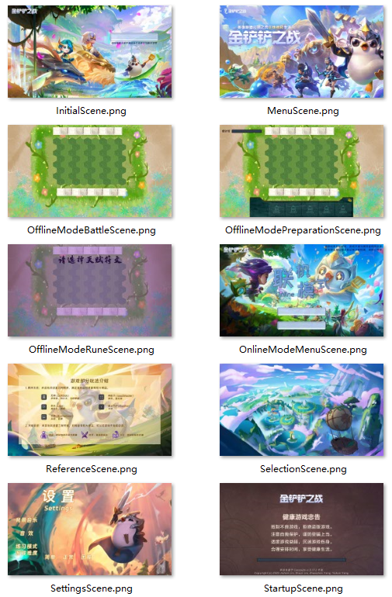
UI Design
This project is designed with a total of 10 scenes based on scene transitions, namely:
1. Initial Scene (InitialScene)
2. Menu Scene (MenuScene)
3. Offline Mode Preparation / Battle Scene (OfflineModePreparation / BattleScene)
4. Offline Mode Rune Selection Scene (OfflineModeRuneScene)
5. Online Mode Menu Scene (OnlineModeMenuScene)
6. Reference Scene (ReferenceScene)
7. Selection of Mini Heroes Scene (SelectionScene)
8. Settings Scene (SettingsScene)
9. Startup Loading Scene (StartupScene)
Cocos2d-x provides two states for buttons: the normal state and the activated state. However, to ensure visually appealing graphics, this project has also designed a hover state for buttons, ensuring a responsive change when the mouse hovers over the buttons. Thus, all buttons exhibit three states: Default, Hover, and Active.
While designing the buttons, the project also took into consideration the consistency with the current scene's color scheme, aiming to create a visually harmonious and aesthetically pleasing interface.
(Hover)

Slide 17
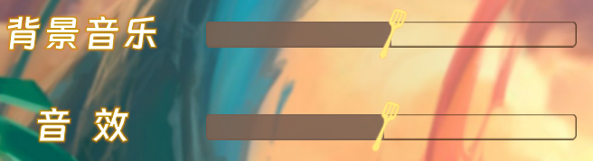
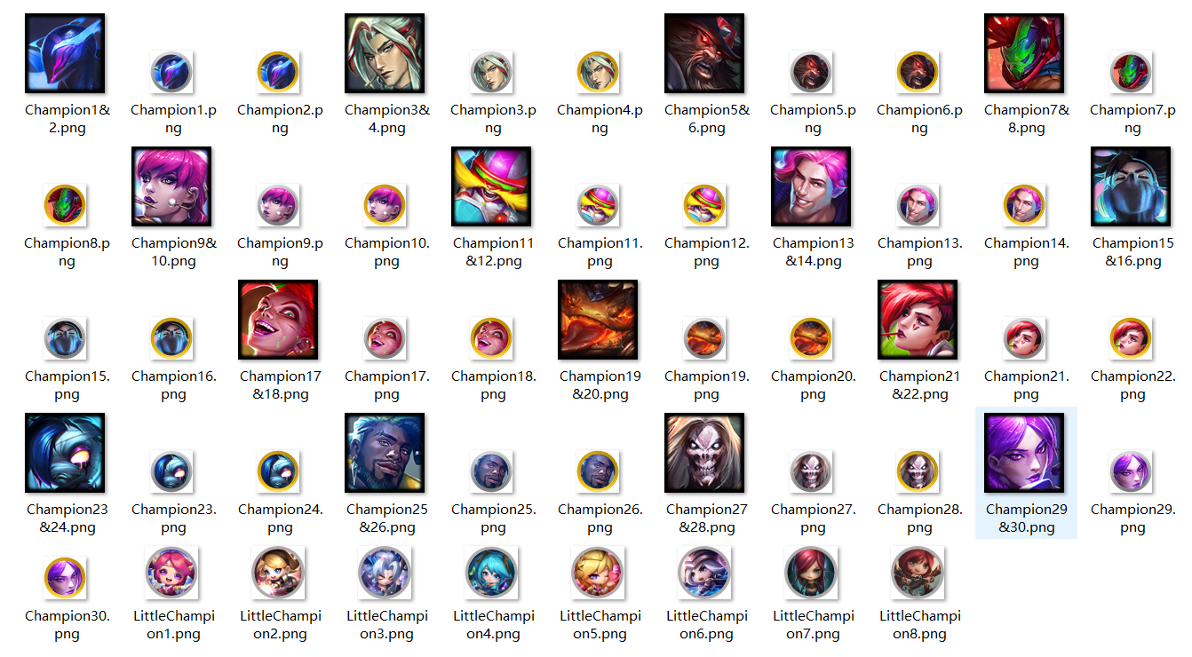
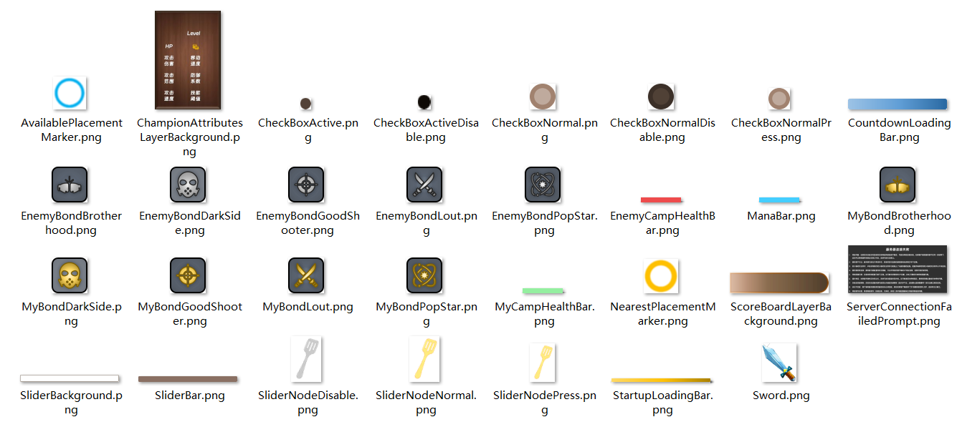
UI Design
In addition to the basic buttons, this project has also designed sliders, progress bars, and checkboxes. These elements are all designed based on the primary color scheme of the current interface. Furthermore, the slider's handle has been designed as a shovel.
The hero's attribute display labels and the store UI have been referenced from the original game, with certain modifications made to ensure harmony with the battle interface. Changes in color and opacity have been applied to maintain consistency and visual coherence with the battle interface.

Slide 18
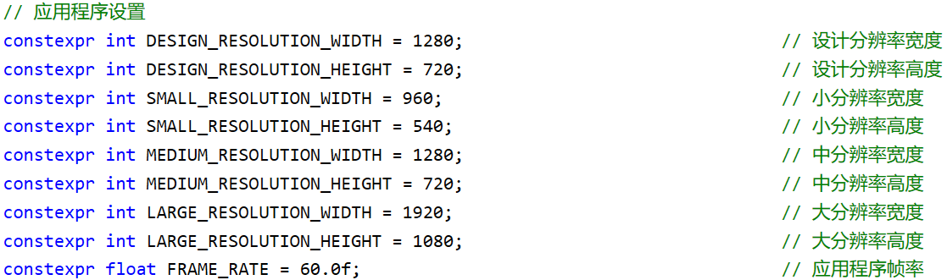
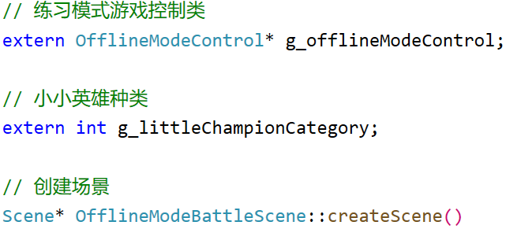
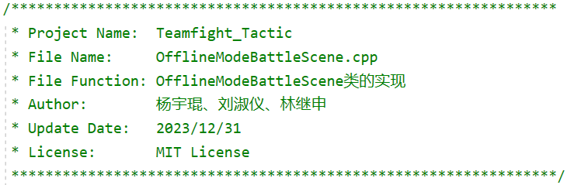
Coding Style
Avoid magic numbers
Good naming conventions
File structure

Slide 19
Implementation of
Project Features
Detailed introduction of features designed in the projects

Slide 20

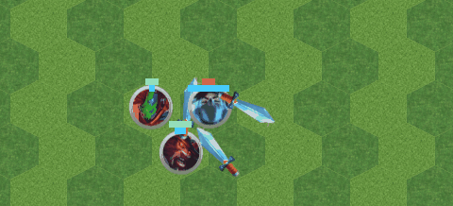
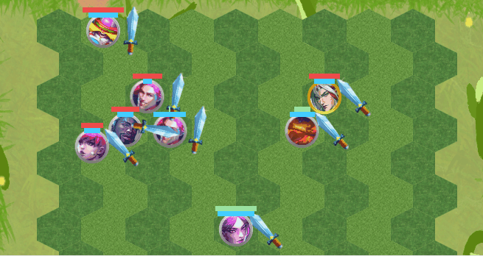
Automatic Battle Logic for Champions
1
Hero's Automatic Enemy Targeting,
Walking, and Attacking
2
The Logic for Clearing Actions
After Champion's Death
3
Champion skills

Slide 21
Automatic Battle Logic for Champions
// 更新战斗英雄
for (int i = 0; i < battleChampionCount; i++) {
if (battleChampion[i] != nullptr) { // 存在战斗英雄
// 设置生命条和经验条
// 检查角色存活
if (battleChampion[i]->getAttributes().healthPoints > 0) { // 角色存活
if (battleChampion[i]->getIsMoving()) { // 角色正在移动
// 增加移动时间间隔
if (battleChampion[i]->getMoveIntervalTimer() >= (1.0f / battleChampion[i]->getAttributes().movementSpeed)) { // 达到停止移动条件
// 停止战斗英雄移动
// 重置移动时间间隔
// 重置战斗英雄移动状态
// 重置当前移动
}
}
else { // 角色停止移动
// 检查是否达到技能触发条件
if (battleChampion[i]->getAttributes().magicPoints >= battleChampion[i]->getAttributes().skillTriggerThreshold) {
// 触发技能
}
// 获取最近敌方战斗英雄
if (battleChampion[i]->getCurrentEnemy()) { // 获取当前锁定敌人战斗英雄指针
// 攻击范围内存在敌人战斗英雄
if (battleChampion[i]->isInAttackRange()) {
// 增加攻击时间间隔
if (battleChampion[i]->getAttackIntervalTimer() >= (1.0f / battleChampion[i]->getAttributes().attackSpeed)) { // 达到攻击时间间隔
// 攻击
// 重置攻击时间间隔
}
}
else { // 攻击范围内不存在敌人战斗英雄
// 设置战斗英雄移动状态
// 设置当前目标位置
// 设置当前移动
// 移动武器
// 移动生命条
// 移动经验条
// 移动战斗英雄
// 放置战斗英雄
// 移除战斗英雄
// 设置当前战斗英雄位置
}
}
}
}
else { // 角色死亡
// 隐藏武器
// 角色死亡
// 置空战斗英雄指针
}
}
}
This Loop is Called once per frame

Slide 22
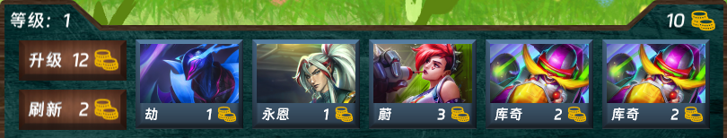
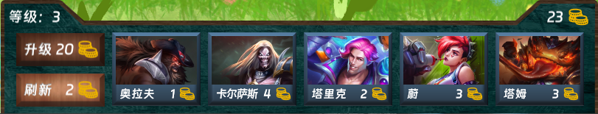
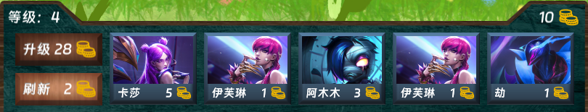
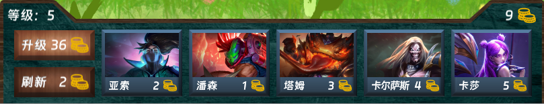
The Shop Recommendation Algorithm

Slide 23
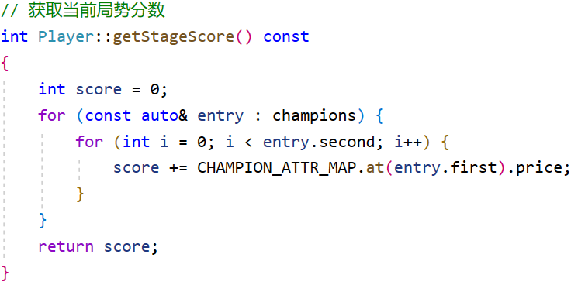
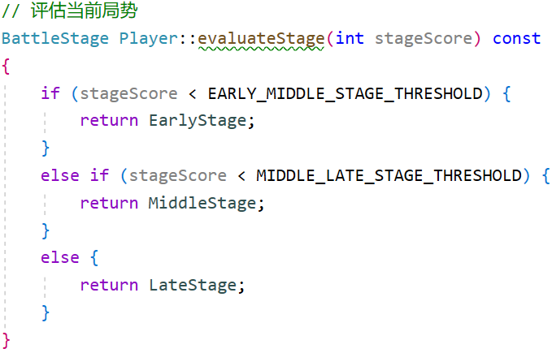
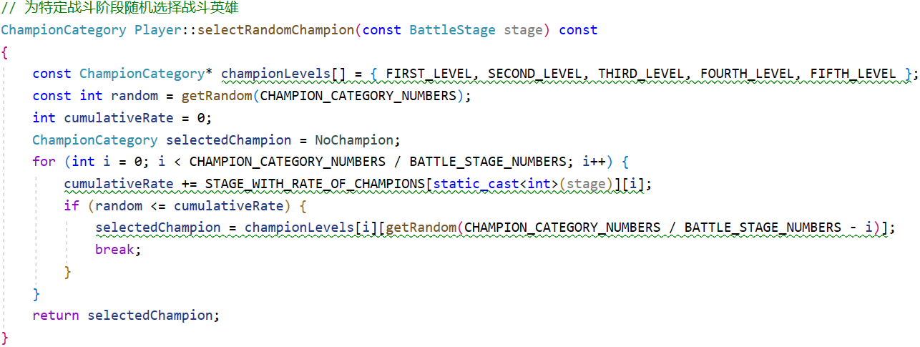
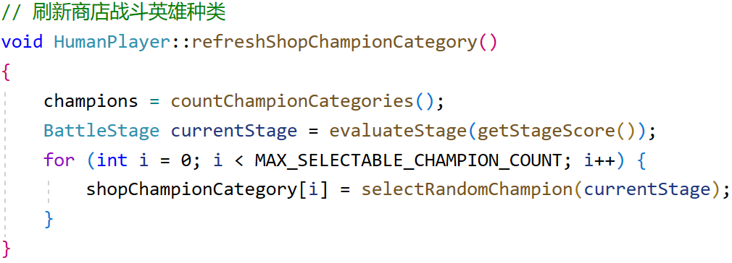
The Shop Recommendation Algorithm
1. Evaluate based on the total value of all heroes
2. Return a Stage
3. Set random number range based on the stage
4. Randomly generate heroes for the five slots

Slide 24


AI Move-Making Algorithms
EarlyStage
MiddleStage
LateStage

Slide 25

AI Move-Making Algorithms
Firstly assess the current owned heroes to determine if purchasing additional heroes would enable an upgrade; if possible, upgrade, otherwise select corresponding heroes based on the current game stage.（Purchase）
Classify all heroes into five categories based on their specific strengths, then assign suitable proportions to each category. Determine the hero‘s strength range of the desired purchase through random number generation and select an appropriate hero from this range using another random number.（Purchase）
Establish an overall rating system for each hero to determine their strength based on an overall assessment. Then, considering the current AI battle difficulty, implement varying hero selection strategies. For hard mode, select the top five heroes with the highest ratings; for easy mode, choose the bottom five heroes with the lowest ratings.（Selection）
For the selected battle heroes, position arrangement strategies vary based on the current difficulty. In general, specific positions are chosen for rows, while column positions are randomly generated.（Placement）

Slide 26
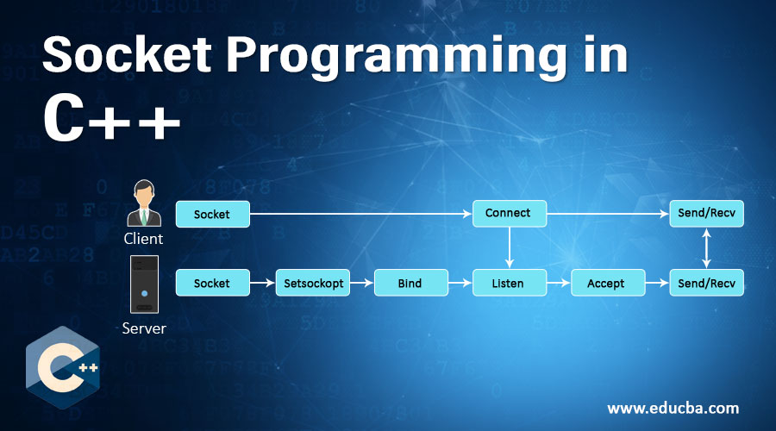
Socket Programming

Slide 27
C++11 New Features
“We are using state-of-the-art tools.”

Slide 28
Type Inference
C++11 introduced the auto and decltype keywords, allowing the compiler to automatically deduce the type of variables or expressions, making coding more convenient and code more concise.
auto: Allows the compiler to deduce the type of a variable at compile time, based on the type on the right-hand side of the assignment.
decltype: Unlike auto, which is used for deducing variable types, decltype is used for deducing expression types. It instructs the compiler to analyze the type of an expression without actually evaluating the expression itself.

Slide 29
Type Inference
In this project, auto and decltype were used for creating variables when dealing with complex data types. This approach facilitated handling complex type expressions, reduced bugs caused by type errors, and improved code maintainability. Examples of their specific usage are provided below.

Slide 30
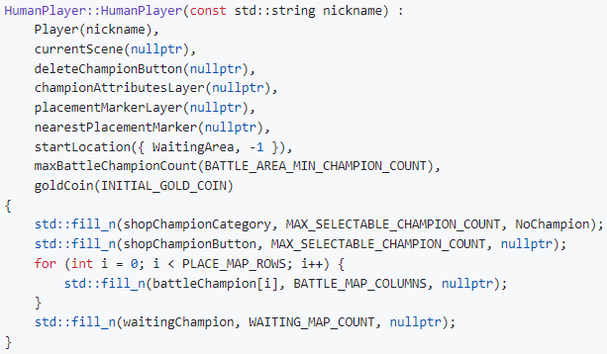
List Initialization
C++11 introduced list initialization, also known as uniform initialization, which is a new syntax using curly braces { } to initialize objects. It offers a more consistent, safer way of initialization and can be used for almost all types of initialization, including primitive data types, objects, arrays, containers, and more.

Slide 31
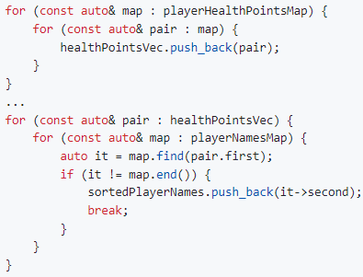
Range-based for loop
C++11 introduced the range-based for loop, a new looping syntax that simplifies and makes iterating over containers (such as arrays, vectors, lists, etc.) and ranges more straightforward. This loop automatically iterates through each element in a container or range without the need for manually managing iterators or indices.

Slide 32
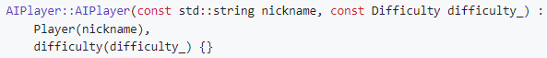
Inherited Constructors
In C++, Inheriting Constructors is a feature introduced in the C++11 standard, allowing derived classes to inherit the constructors of their base class. This feature primarily addresses the issue of redundant code in derived classes by eliminating the need to rewrite code identical to the base class constructors, thereby enhancing code maintainability and conciseness.

Slide 33
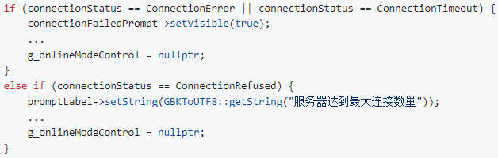
nullptr Keyword
C++11 introduced the nullptr keyword, which is a literal representing a null pointer. It serves as a replacement for the traditional NULL used in previous C++ standards. In earlier standards, NULL was often defined as 0 or ((void*)0), which could lead to type ambiguities and some hard-to-detect errors. The introduction of nullptr addresses these issues and provides a clearer and safer way to represent a null pointer.

Slide 34
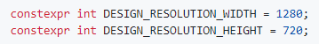
constexpr Keyword
constexpr is a keyword introduced in C++11 for compile-time constants and constant functions. Variables or functions marked with constexpr are true constants that are computed at compile time and cannot be altered during runtime. constexpr can be applied to functions, and the return value of such functions is computed as a constant at compile time whenever possible. However, if the function cannot be evaluated at compile time, it is treated as a regular function.

Slide 35
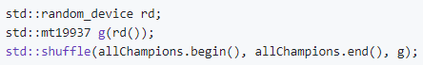
New Random Number Generation Library
C++11 introduced a comprehensive random number generation library that offers various random number generators (RNGs) and probability distributions. This library's design aims to address the limitations of the random number functionalities in older C++ standards, providing a more flexible, efficient, and type-safe approach to generating random numbers.

Slide 36
The chrono Library and thread Library's this_thread Namespace
C++11 introduced the chrono library for time handling, providing representations for time points, durations, and clocks.
Additionally, the C++11 standard introduced the <thread> library, which allows control and management of threads. Within this library, std::this_thread is a namespace that offers functions related to the current thread. Particularly, std::this_thread::sleep_for is a function used to make the current thread sleep for a specified duration of time.

Slide 37
Unicode
In C++11, support for Unicode was introduced along with several new string literals. In this project, the u8 prefix is utilized to denote a string literal in UTF-8 encoding. UTF-8 is a variable-width character encoding used for encoding Unicode characters. This facilitates C++ programs to handle multiple languages and character sets more seamlessly.

Slide 38
Conclusion and Review
Understanding of OOP principles and future feature expansion

Slide 39
Fundamental Principles
01
Encapsulation
Bundling of data (attributes) and methods that operate on the data within a single unit.
02
Abstraction
OOP
Emphasizing essential details while hiding unnecessary information from the user.
03
Inheritance and Polymorphism
One class can inherit properties and behaviors from another class Polymorphism allows objects of different classes to be treated as objects of a common superclass.

Slide 40

Usage of Pointer
1. Dynamic Object Allocation and Management: In OOP languages, objects are often dynamically allocated using new (in C++) or similar methods. Pointers are used to store the addresses of these objects, allowing for dynamic creation, access, and management of objects.
2. Implementation of Polymorphism: Polymorphism is a key concept in OOP that allows objects of different classes to be treated as instances of a common superclass. Pointers or references are commonly used to point to different objects of various classes, facilitating polymorphic behavior through virtual functions or interfaces.
3. Object Association and Reference: OOP allows objects to reference or associate with each other. Pointers facilitate the creation of complex relationships and data structures, such as linked lists, trees, etc., by enabling objects to reference one another.
4. Enhancing Program Performance: In certain scenarios, using pointers can enhance program performance as they enable direct memory access without the overhead of copying data. This can be advantageous for large data structures or situations requiring frequent memory access.
5. Memory Management and Resource Deallocation: Objects allocated on the heap need to be manually deallocated to prevent memory leaks. Pointers are used to track dynamically allocated memory and enable the release of memory using delete operations when the objects are no longer needed.

Slide 41
Future Plan
01
02
03
Online Mode
UI Design
Champion Diversity

Slide 42
THANK YOU
2024 - 01 - 02
2250758 林继申 (组长)
2251730 刘淑仪
2252712 杨兆镇
2252843 杨宇琨
GitHub: https://github.com/MinmusLin/Teamfight_Tactics
Speaker: 杨宇琨 林继申

